Slide 1
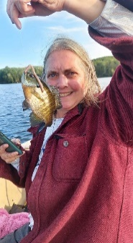
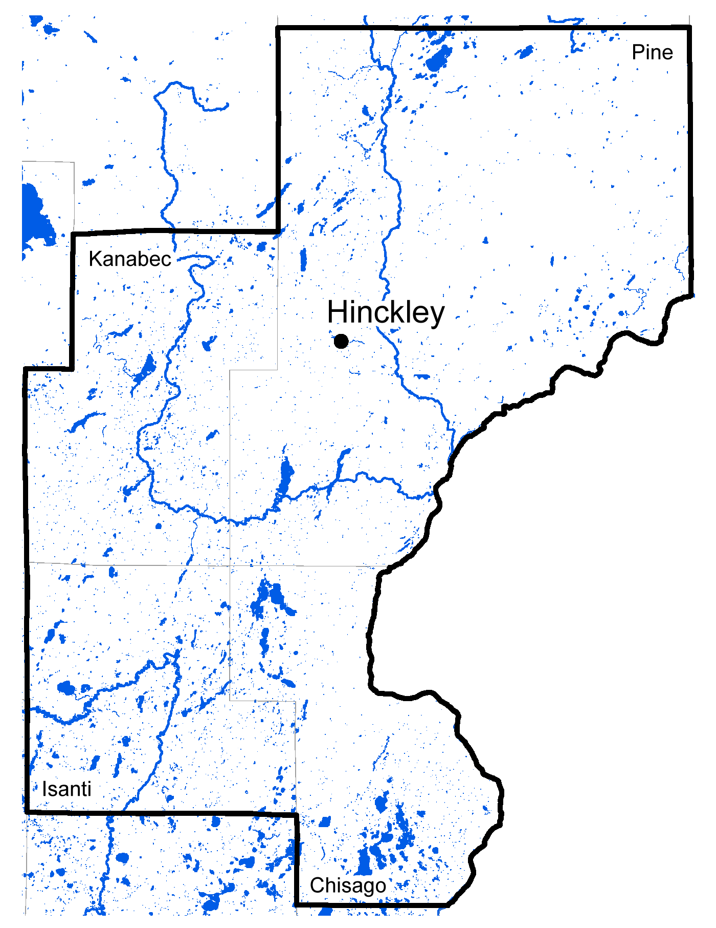
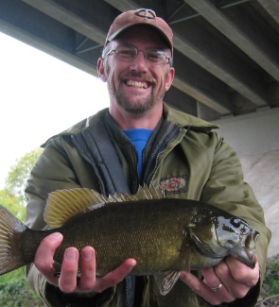
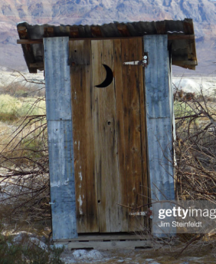
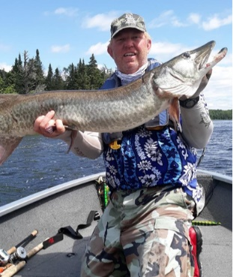
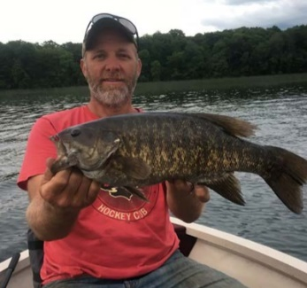
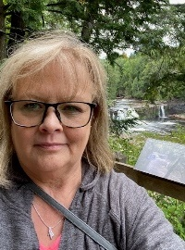
Hinckley Area Fisheries
Hinckley Fisheries have raised a substantial portion of the fingerling muskellunge for statewide stocking the past several years. Our fish have gone all over the place, even places where they were not welcomed with open arms.
One of the biggest challenges facing the Hinckley area is the removal of the Grindstone River Dam in Hinckley. The process started over three years ago and the dam is still standing. Lots of forms, procedures, and meetings to complete before it goes. Where is the 100-year flood when you really need it? (If Leslie would just let John use his explosives training, it would have been gone a long time ago)
Hinckley Fun Facts:
On a per square foot basis, we likely have the cheapest office cost in the state.
The Hinckley Fisheries Area has 180 miles of National or State Designated Scenic Riverway
All the current staff at the Hinckley Fisheries Office are over 50 years old
Deb Vermeersch
Assistant Area Supervisor
29 yrs service
Heath Weaver
Fisheries Specialist
30 yrs service
Hinckley Area Manager Office
VACANT
Area Supervisor
John Frank
Fisheries Specialist
23 yrs service
Nate Painovich
Fisheries Specialist
20 yrs service
OASI – Shelly O’Donovan
14 Yrs service

Slide 2
Pine and Big Pine Lake management plans
Surveys: every 8 years, last in 2022
Stocking: Walleye fingerlings in even numbered years + NEW: Annual walleye fry stocking (Lower Mississippi strain)
Other monitoring: shoreline fish species, vegetation, public waters permits, Clean Water Act watershed monitoring
Management concerns: Low walleye numbers in the last 20 years

Slide 3
Fish summary from 2022 surveys
Northern pike- Good size distribution (average 26”) and low to moderate numbers (22-26 inch protected slot in N central MN, limit 10, 2 over 26”)
Largemouth bass- moderate numbers, average weight 2 pounds
Crappie- Good numbers, some good sized fish especially in Big Pine
Sunfish- Good numbers and sizes (keep medium sized 5-7” when possible, release larger ones)
Perch- Good numbers (important food for walleye, bass and northern pike), smaller sizes

Slide 4
Walleye
Numbers up from last survey, still low compared with 20+ years ago
Some were from non-stocked years (2017 and 2019). Sources? Strawberry Creek, Pine River, ??

Slide 5
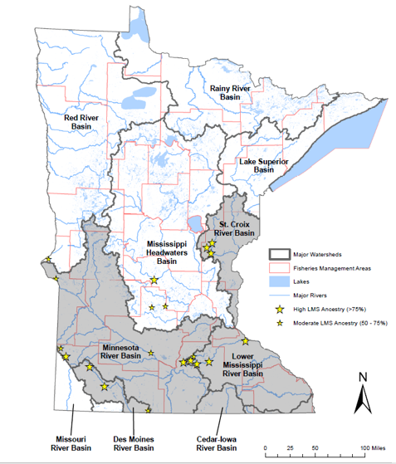
Minnesota walleye genetics (“ancestry.com for fish”)
Used to stock walleye from wherever we could get them
Recent studies have shown that certain strains do better in their native watersheds
Lower Mississippi Strain linked to St. Croix watershed
Hinckley staff collected eggs from Knife River north of Mora in 2023; Pine Lakes stocked

Slide 6
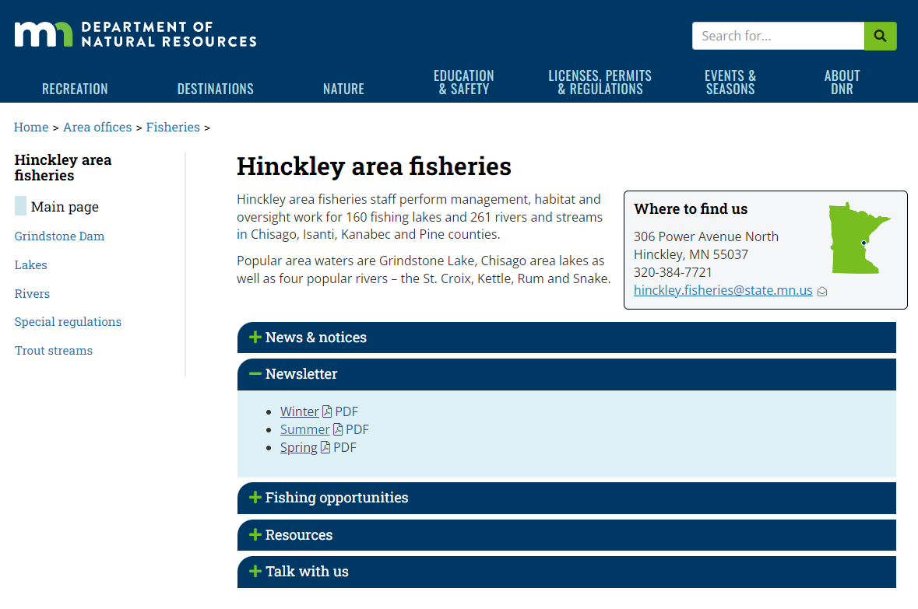
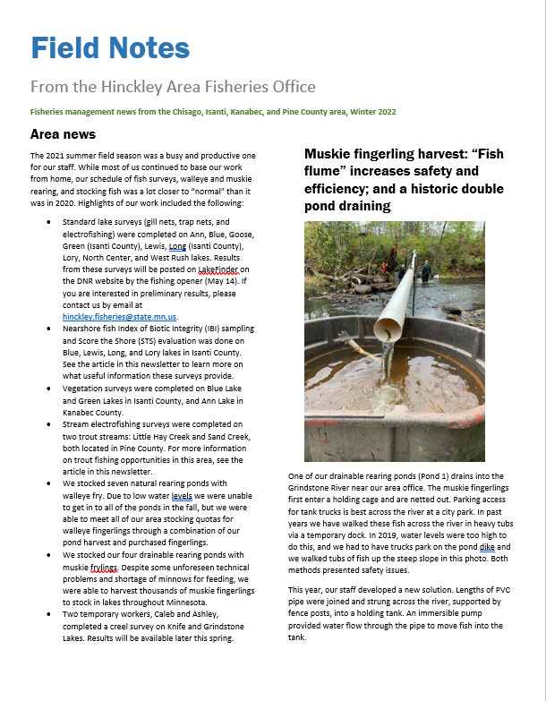
Public information

Slide 7
General DNR information
Call 1-888-646-6367 (MINN DNR) or email info.dnr@state.mn.us to:
Ask questions about regulations, licenses, wildlife, outdoor recreation, state lands…
Contact a Conservation Officer
Turn In Poachers (TIP) line 1-800-652-9093

